Slide 1


Systems, Roles, and Development Methodologies
CS456: Advanced System Analysis & Design
Session 1
Ferdinand Hiagbe

Slide 2


Objectives of this lesson
1. Recall the basic types of computer-based systems that a systems analyst needs to address.
2. Understand how users working in context with new technologies change the dynamics of a system.
3. Realize what the many roles of a systems analyst are.
4. Comprehend the fundamentals of three development methodologies: SDLC, the agile approach, and object-oriented systems analysis and design.
5. Understand what CASE tools are and how they help a systems analyst.

Slide 3
Types of Computer-based systems
Section 1/3

Slide 4
Types of Computer-based systems
Transaction Processing Systems
Office Automation Systems
Knowledge Management Systems
Management Information Systems
Decision Support Systems
Executive Support System
Artificial Intelligence and Expert Systems

Slide 5
Transaction Processing Systems (1 of 2)
Transaction processing systems are used to record day to day business transactions of the organization. They are used by users at the operational management level.
The main objective of a transaction processing system is to answer routine questions such as:
  How many items were sold today?
  How much inventory do we have at hand?
  What is the outstanding due for John Doe?

Slide 6
Transaction Processing Systems (1 of 2)
By recording the day-to-day business transactions, TPS system provides answers to the above questions in a timely manner.
  The decisions made by operational managers are routine and highly structured.
  The information produced from the transaction processing system is very detailed.
Examples of transaction processing systems include;
  Point of Sale Systems – records daily sales
  Payroll systems – processing employees’ salary, loans management, etc.
  Stock Control systems – keeping track of inventory levels
  Airline booking systems – flights booking management

Slide 7
Office Automation Systems
An office automation system is a network of various tools, technologies, and people required to conduct clerical and managerial tasks.
Primarily, an office automation system assists in enhancing communication among different departments so everyone can collaborate to complete a task.
Typical examples of functions performed by an OAS include printing documents, mailing paperwork, mailing, maintaining a company calendar, and producing reports.

Slide 8
Knowledge Management Systems
A knowledge management system stores and extracts information to help users enhance their knowledge and optimize collaboration efforts to complete tasks.
A KMS is used by employees, customers, management, and other various stakeholders involved with the organization. It ensures that technical abilities are integrated throughout the company while providing visuals to help employees make sense of the data they see.
Examples of documents found in a knowledge management system include employee training materials, company policies, and procedures, or answers to customer questions.

Slide 9
Management Information Systems
A management information system uses various transaction data from a TPS to help middle management optimize planning and decision-making.
It retrieves TPS information, aggregates it, and generates reports to help those at the management level know important details of a situation. Summaries and comparisons are utilized to allow senior managers to optimize the decision-making process to achieve better results.
Most of the report formats encompass summaries of annual sales data, performance data, or historical records.

Slide 10
Decision Support Systems (1 of 2)
A decision support system processes data to assist in management decision-making. It stores and gathers the information required for management to take the proper actions at the correct time.
For example, a bank manager can use a DSS to assess the evolving loan trends to determine which yearly loan targets to meet.

Slide 11
Decision Support Systems (2 of 2)
Decision support systems answer questions such as;
  What would be the impact of employees' performance if we double the production lot at the factory?
  What would happen to our sales if a new competitor entered the market?
Decision models are programmed into the IS to analyze and summarize large quantities of information and put it into a visual that makes it understandable.
Decision support systems use sophisticated mathematical models, and statistical techniques (probability, predictive modeling, etc.) to provide solutions, and they are very interactive.

Slide 12
Executive Support System
Executive support systems are similar to a DSS but are primarily used by executive leaders and owners to optimize decision-making.
Graphics software is integrated within an ESS to display data about tax regulations, new competitive startups, internal compliance issues, and other relevant executive information. This allows leaders to track internal performance, monitor the competition, and pinpoint growth opportunities.

Slide 13
Artificial Intelligence and Expert Systems
Artificial intelligence (AI) can be considered the overarching field for expert systems. The general thrust of AI has been to develop machines that behave intelligently. Two avenues of AI research are (1) understanding natural language and (2) analyzing the ability to reason through a problem to its logical conclusion. Expert systems use the approaches of AI reasoning to solve the problems put to them by business (and other) users.
Expert systems are a very special class of information system that has been made practicable for use by business as a result of widespread availability of hardware and software such as personal computers (PCs) and expert system shells. An expert system (also called a knowledge-based system) effectively captures and uses the knowledge of a human expert or experts for solving a particular problem experienced in an organization. Notice that unlike DSS, which leave the ultimate judgment to the decision maker, an expert system selects the best solution to a problem or a specific class of problems.

Slide 14
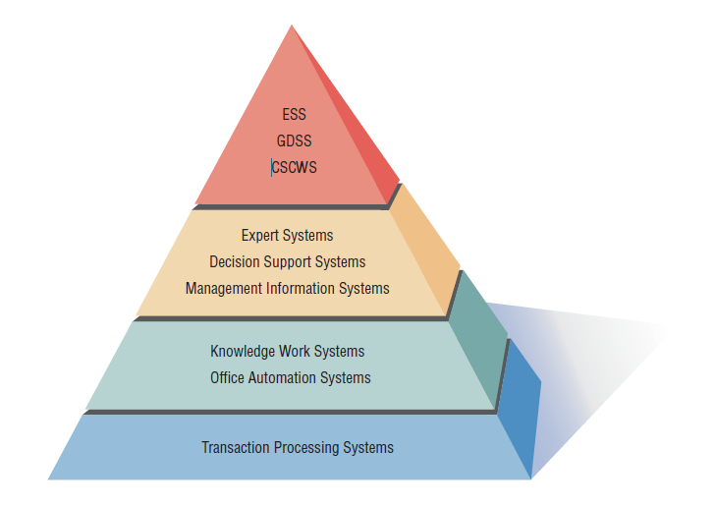
A systems analyst may be involved with any or all of these systems.

Slide 15
Need for Systems Analysis and Design
Section 2/5

Slide 16
Need for Systems Analysis and Design
Installing a system without proper planning leads to great user dissatisfaction and frequently causes the system to fall into disuse
Systems analysis and design lends structure to the analysis and design of information systems
User involvement throughout a systems project is critical to the successful development of computerized systems

Slide 17
Roles of the Systems Analyst
The analyst must be able to work with people of all descriptions and be experienced in working with computers
Three primary roles:
  Consultant
  Supporting Expert
  Agent of change

Slide 18
Qualities of the Systems Analyst
From the foregoing descriptions of the roles the systems analyst plays, it is easy to see that the successful systems analyst must possess a wide range of qualities. Many different kinds of people are systems analysts, so any description is destined to fall short in some way. There are some qualities, however, that most systems analysts seem to display:
  Problem solver
  Communicator
  Strong personal and professional ethics
  Self-disciplined and self-motivated

Slide 19
Systems Development Life Cycle (SDLC)
The systems development life cycle is a phased approach to solving business problems
Developed through the use of a specific cycle of analyst and user activities
Each phase has unique user activities

Slide 20
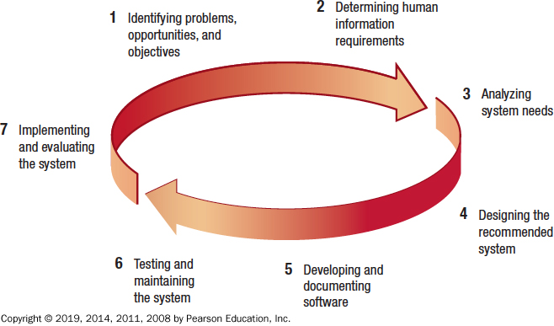
Figure 1.1 The Seven Phases of the Systems Development Life Cycle

Slide 21
Identifying Problems, Opportunities, and Objectives
Activity:
  Interviewing user management
  Summarizing the knowledge obtained
  Estimating the scope of the project
  Documenting the results
Output:
  Feasibility report containing problem definition and objective summaries from which management can make a decision on whether to proceed with the proposed project

Slide 22
Determining Human Information Requirements (1 of 2)
Activity:
  Interviewing
  Sampling and investing hard data
  Questionnaires
  Observe the decision maker’s behavior and environment
  Prototyping
  Learn the who, what, where, when, how, and why of the current system

Slide 23
Determining Human Information Requirements (1 of 2)
Output:
  Analyst understands how users accomplish their work when interacting with a computer
  Begin to know how to make the new system more useful and usable
  The analyst should also know the business functions
  Have complete information on the people, goals, data and procedure involved

Slide 24
Analyzing System Needs
Activity:
  Create data flow diagrams
  Complete the data dictionary
  Analyze the structured decisions made
  Prepare and present the system proposal
Output:
  Recommendation on what, if anything, should be done

Slide 25
Designing the Recommended System
Activity:
  Design procedures to accurately enter data
  Design the human–computer interface (HCI)
  Design files and/or database
  Design backup procedures
Output
  Model of the actual system

Slide 26
Developing and Documenting Software
Activity:
  System analyst works with programmers to develop any original software
  Works with users to develop effective documentation
  Coders design, code, and remove syntactical errors from computer programs
  Document software with procedure manuals, online help, Frequently Asked Questions (F A Q) and Read Me files
Output:
  Computer programs
  System documentation

Slide 27
Testing and Maintaining the System
Activity:
  Test the information system
  System maintenance
  Maintenance documentation
Output:
  Problems, if any
  Updated programs
  Documentation

Slide 28
Implementing and Evaluating the System
Activity:
  Train users
  Plans the conversion from old system to new system
  Review and evaluate system
Output:
  Trained personnel
  Installed system

Slide 29
The Impact of Maintenance
Maintenance is performed for two reasons
  Remove software errors, and
  Enhance existing software
Enhance software for three reasons
  Include additional features
  Address business changes over time
  Address hardware and software changes

Slide 30
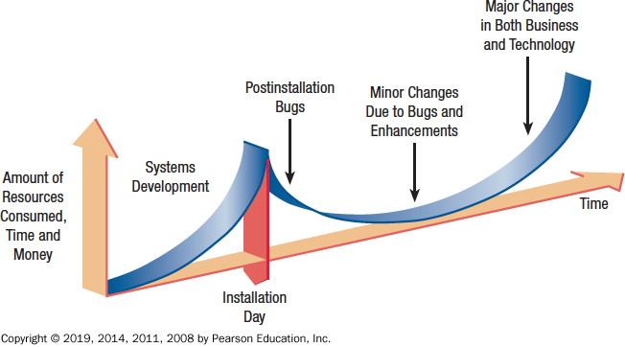
Figure 1.2 Resource Consumption Over the System Life

Slide 31
Case Tools
CASE (computer aided software engineering) tools are productivity tools for systems analysts that have been created explicitly to improve their routine work through the use of automated support
Reasons for using CASE tools
  Improving Analyst–User Communication
  Help support modeling functional requirements
  Assist in drawing project boundaries

Slide 32
Agile Approach
Section 3/5

Slide 33
The Agile Approach
Although this course tends to focus on SDLC, the most widely used approach in practice, at times the analyst will recognize that the organization could benefit from an alternative approach. Perhaps a systems project using a structured approach has recently failed, or perhaps the organizational subcultures, composed of several different user groups, seem more in step with an alternative method.
The agile approach is a software development approach based on
  Values
  Principles
  Core practices

Slide 34
Agile Values
The four values are
  Communication
  Simplicity
  Feedback
  Courage

Slide 35
Agile Approach
Agile approach is
  Interactive
  Incremental
Frequent iterations are essential for successful system development

Slide 36
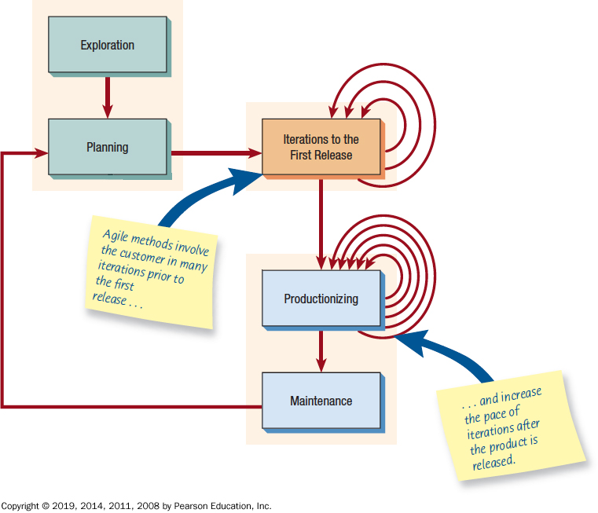
Figure 1.4 The Five Stages of the Agile Modeling Development Process

Slide 37
Exploration
Assemble team
Assess skills
Examine potential technologies
Experiment with writing user stories
Adopt a playful and curious attitude toward the work environment, its problems, technologies, and people

Slide 38
Planning
Rules that can help formulate the agile development team’s relationship with their business customers
Maximize the value of the system produced by the agile team
Main players are the development team and the business customer

Slide 39
Iterations to the First Release
Iterations are cycles of
  Testing
  Feedback
  Change
One goal is to run customer-written function tests at the end of each iteration

Slide 40
Productionizing
The product is released in this phase
May be improved by adding other features

Slide 41
Maintenance
New features may be added
Riskier customer suggestions may be considered
Team members may be rotated on or off the team

Slide 42
Object-Oriented Systems Analysis and Design
Section 1/3

Slide 43
Object-Oriented Systems Analysis and Design
Alternate approach to the structured approach of the SDLC that is intended to facilitate the development of systems that must change rapidly in response to dynamic business environments
Use unified modeling language (UML) to model object-oriented systems
Each object is a computer representation of some actual thing or event

Slide 44
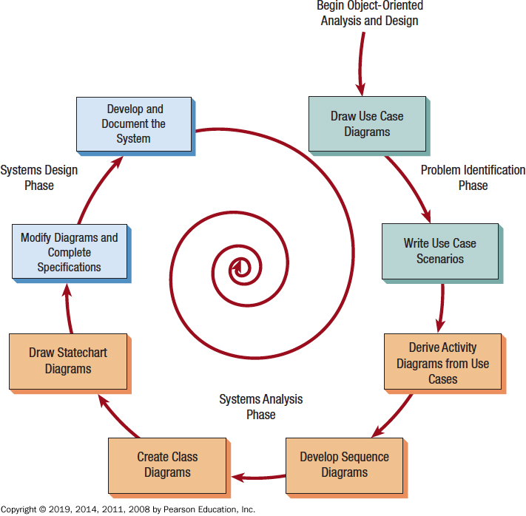
Figure 1.5 The Steps in the UML Development Process

Slide 45
Define the Use Case Model
Identify the actors and the major events initiated by the actors
Draw a use case diagram
A diagram with stick figures representing the actors and arrows showing how the actors relate

Slide 46
Begin Drawing U M L Diagrams
Draw activity diagrams, which illustrate all the major activities in the use case
Create one or more sequence diagrams for each use case that show the sequence of activities and their timing
Review the use cases, rethink them, and modify them if necessary

Slide 47
Analysis Phase
Develop class diagrams
Draw state chart diagrams

Slide 48
System Design
Modifying the existing system
Modifying the diagrams drawn in the previous phase
Write class specifications for each class

Slide 49
Develop and Document the System
The more complete the information you provide to the development team through documentation and U M L diagrams, the faster the development and the more solid the final production system

Slide 50
Figure 1.6 How to Decide Which Development Method to Use
Choose | When
The Systems Development Life Cycle (S D L C) Approach | systems have been developed and documented using S D L C it is important to document each step of the way upper-level management feels more comfortable or safe using S D L C there are adequate resources and time to complete the full S D L C communication of how new systems work is important
Agile Methodologies | there is a project champion of agile methods in the organization applications need to be developed quickly in response to a dynamic environment a rescue takes place (the system failed and there is no time to figure out what went wrong) the customer is satisfied with incremental improvements executives and analysts agree with the principles of agile methodologies
Object-Oriented Methodologies | the problems modeled lend themselves to classes an organization supports the U M L learning systems can be added gradually, one subsystem at a time reuse of previously written software is a possibility it is acceptable to tackle the difficult problems first

Slide 51
Q&A
Ferdinand Hiagbe

